Slide 2
THE NEXT FEW YEARS
Beton Bauen believes the construction industry is responsible for playing a lead role in reserving the present and creating a sustainable future. Beton Bauen currently undertakes the following:
Reduce environmental impact wherever possible, using best practice methods and standards
Achieve and maintain high levels of sustainable working that enhances our reputation and those of our customers and stakeholders
Ensure compliance to all regulations and statutory bodies with regards the environment and sustainability
Collaborate within partnerships and supply chains and seek to embed “sustainable thinking” across activities throughout

Slide 3
Maintain continual improvement through measurement against policy and performance, evaluation, review, training and procedural change where required
Invest in our employees through programmes of best-practice employment, offering training opportunities, rewards, and fair contractual arrangements that mutually benefit both employer and employee
Reduce, reuse and recycle wherever practicable
Source recycled materials or other materials from sustainable sources
Seek to reduce carbon emissions, water consumption and energy use across our operations and those within supply chains and partnerships
Reduce any adverse impacts on the communities our operations affect, while simultaneously seek to source locally to aid local economies
Engage local communities through education, project liaison, and support them through charitable work, sponsorship and other support initiatives
Meet our clients' requirements and meet or exceed their expectations

Slide 4
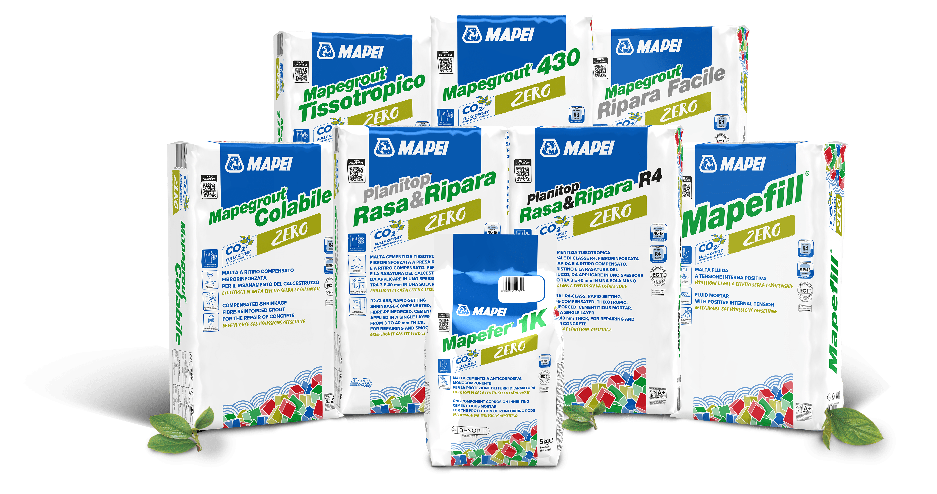
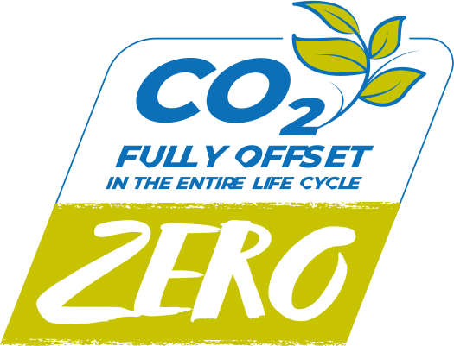
WORKING WITH PARTNERS
Beton Bauen’s preferred choice for concrete repair is Mapei ‘Zero Repair Mortars.

Slide 5
THE FUTURE
Beton Bauen believes the construction industry has a responsibility in playing a lead role in creating a sustainable future. In the future Beton Bauen plans to undertake the following:
Invest in further ‘green’ infrastructure at Beton Bauen, including light sensors, electric/hybrid vehicles, and solar renewable energy sources.
Whole Life Cycle Analysis to measure the impact on the use of our products have over the life of a structure and looking then at their subsequent recycling potentials
Investing in developing product partnerships to further reduce our product materials carbon footprint, like the one we have with Mapei
Investing in our plant to ensure that where possible we use electric tools and plant. Ensure equipment is running as environmentally efficient as it can

